Slide 1
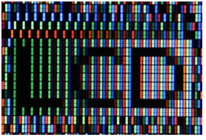
LCD
A liquid crystal display or LCD draws its definition from its name itself. It is combination of two states of matter, the solid and the liquid.
LCD uses a liquid crystal to produce a visible image. Liquid crystal displays are super-thin technology display screen that are generally used in laptop computer screen, TVs, cell phones and portable video games.
LCD’s technologies allow displays to be much thinner when compared to cathode ray tube (CRT) technology.

Slide 2
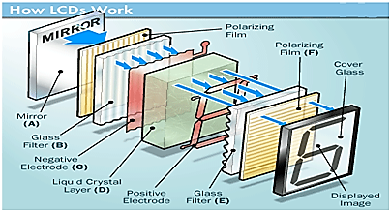
LCD

Slide 3
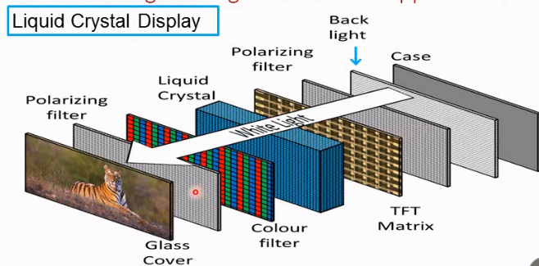

Slide 4
LCD
The principle behind the LCD’s is that when an electrical current is applied to the liquid crystal molecule, the molecule tends to untwist.
This causes the angle of light which is passing through the molecule of the polarized glass to change and also cause a change in the angle of the top polarizing filter.
As a result a little light is allowed to pass the polarized glass through a particular area of the LCD.
Thus that particular area will become dark compared to other.
The LCD works on the principle of blocking light.
While constructing the LCD’s, a reflected mirror is arranged at the back. An electrode plane is made of indium-tin oxide which is kept on top and a polarized glass with a polarizing film is also added on the bottom of the device.
The complete region of the LCD has to be enclosed by a common electrode and above it should be the liquid crystal matter.

Slide 5
LCD
Next comes to the second piece of glass with an electrode in the form of the rectangle on the bottom and, on top, another polarizing film.
It must be considered that both the pieces are kept at right angles.
When there is no current, the light passes through the front of the LCD it will be reflected by the mirror and bounced back.
As the electrode is connected to a battery the current from it will cause the liquid crystals between the common-plane electrode and the electrode shaped like a rectangle to untwist.
Thus the light is blocked from passing through. That particular rectangular area appears blank.

Slide 6
Antenna
An antenna is a specialized transducer that converts radio-frequency (RF) fields into alternating current (AC) or vice-versa.
An antenna is a metallic structure that captures and/or transmits radio electromagnetic waves.
An antenna produces both electric and magnetic fields that are perpendicular to one another, as well as to the direction of propagation.
At frequencies below 3 GHz, many different types of antennas are used.
Antennas demonstrate a property known as reciprocity, which means that an antenna will maintain the same characteristics regardless if it is transmitting or receiving.
There are two basic types:
Receiving antenna, which intercepts RF energy and delivers AC to electronic equipment
Transmitting antenna, which is fed with AC from electronic equipment and generates an RF field.

Slide 7
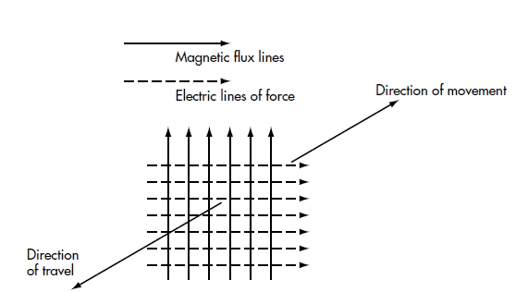

Slide 8
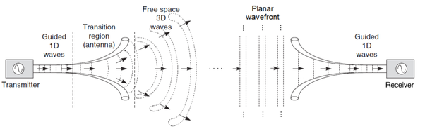
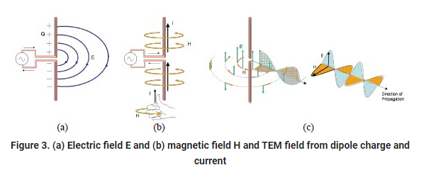
Antenna
Fundamentally, from Maxwell’s equations, Electromagnetic waves are generated by accelerating electric currents and conductors carry those currents.
The EM waves that are generated then propagate through space.
The goal of antenna design is to ensure that the conversion between current and radiation occurs as efficiently as possible and that power is transmitted or received with desired characteristics.

Slide 9
Magnetic Cartridge
A magnetic cartridge, more commonly called a phonograph cartridge or phono cartridge or (colloquially) a pickup, is an electromechanical transducer that is used to play records on a turntable.
The basic principle of phonograph sound reproduction stems from a small diameter diamond needle follows a groove cut into the surface of a record.
The resulting needle velocity is mechanically coupled to one element of an electrical coil transducer to produce an electrical current.

Slide 10
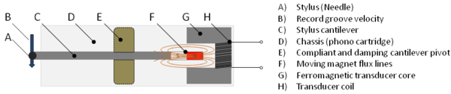
Magnetic Cartridge
The cartridge contains a removable or permanently mounted stylus, the tip - usually a gemstone, such as diamond or sapphire - of which makes physical contact with the record's groove.
As the stylus tracks the serrated groove, it vibrates a cantilever on which is mounted a permanent magnet which moves between the magnetic fields of sets of electromagnetic coils in the cartridge.
The shifting magnetic fields generate an electrical current in the coils.
The electrical signal generated by the cartridge can be amplified and then converted into sound by a loudspeaker.

Slide 11
Geiger Muller Tubes
Geiger counter is also called as Geiger tube.
This instrument is actually used for detecting and measuring ionizing radiation like alpha particles, beta particles, and gamma rays.
A Geiger-Müller counter can count individual particles at rates up to about 10,000 per second and is used widely in medicine and in prospecting for radioactive ores.
The unit for measuring radioactive emissions is the becquerel (Bq). The Bq indicates the number of decays per second.

Slide 12
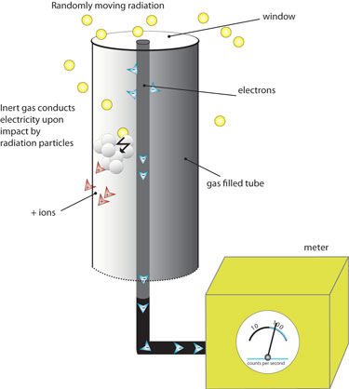
Geiger Muller Tubes
The counter consists of a tube filled with an inert gas that becomes conductive of electricity when it is impacted by a high-energy particle.
When a Geiger counter is exposed to ionizing radiation, the particles penetrate the tube and collide with the gas, releasing more electrons.
Positive ions exit the tube and the negatively charged electrons become attracted to a high-voltage middle wire.
When the number of electrons that build up around the wire reaches a threshold, it creates an electric current.
This causes the temporary closing of a switch and generates an electric pulse that is registered on a meter

Slide 13
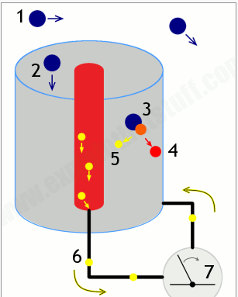

Slide 14
Radio Transmitter & Receiver
A radio transmitter consists of several elements that work together to generate radio waves that contain useful information such as audio, video, or digital data.
Power supply: Provides the necessary electrical power to operate the transmitter.
Oscillator: Creates alternating current at the frequency on which the transmitter will transmit. The oscillator usually generates a sine wave, which is referred to as a carrier wave.
Modulator: Adds useful information to the carrier wave. There are two main ways to add this information. The first, called amplitude modulation or AM, makes slight increases or decreases to the intensity of the carrier wave. The second, called frequency modulation or FM, makes slight increases or decreases the frequency of the carrier wave.
Amplifier: Amplifies the modulated carrier wave to increase its power. The more powerful the amplifier, the more powerful the broadcast.
Antenna: Converts the amplified signal to radio waves.

Slide 15
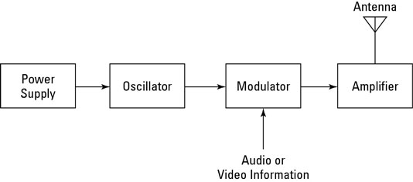
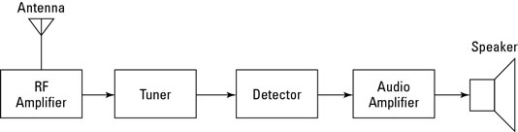
Radio Transmitter & Receiver

Slide 16
Radio Transmitter & Receiver
Radio receiver is the opposite of a radio transmitter. It uses an antenna to capture radio waves, processes those waves to extract only those waves that are vibrating at the desired frequency, extracts the audio signals that were added to those waves, amplifies the audio signals, and finally plays them on a speaker.
Antenna: Captures the radio waves. Typically, the antenna is simply a length of wire. When this wire is exposed to radio waves, the waves induce a very small alternating current in the antenna.
RF amplifier: A sensitive amplifier that amplifies the very weak radio frequency (RF) signal from the antenna so that the signal can be processed by the tuner.
Tuner: A circuit that can extract signals of a particular frequency from a mix of signals of different frequencies. On its own, the antenna captures radio waves of all frequencies and sends them to the RF amplifier, which dutifully amplifies them all.
Detector: Responsible for separating the audio information from the carrier wave. For AM signals, this can be done with a diode that just rectifies the alternating current signal. What’s left after the diode has its way with the alternating current signal is a direct current signal that can be fed to an audio amplifier circuit. For FM signals, the detector circuit is a little more complicated.
Audio amplifier: This component’s job is to amplify the weak signal that comes from the detector so that it can be heard. This can be done using a simple transistor amplifier circuit.

